Slide 1
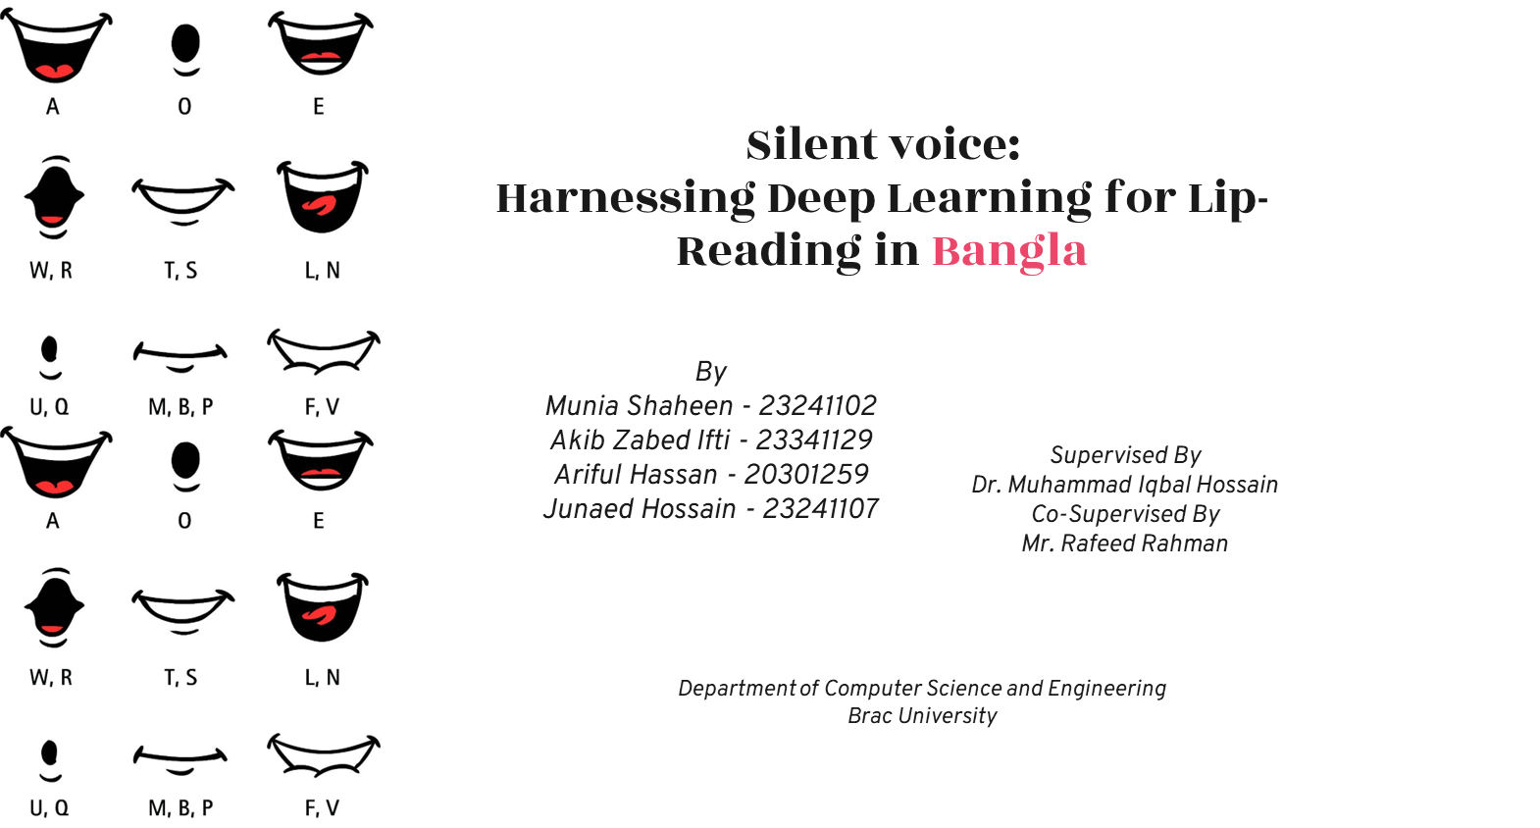
1
আ
অ,ও
এ
উ,ঔ
ই,ঈ
জ,ব
ক,খ
ম,য
প,ভ
আ
অ,ও
এ
উ,ঔ
ই,ঈ
জ,ব
ত,ঠ
থ,ঝ
ফ

Slide 2

Lip-Reading
Why do we need it?
2
Technique for understanding speech through lip movements alone.
Practiced by humans but challenging to automate.
Involves several processes: face recognition, lip localization, feature extraction
Complicated by issues like homophones, light, distance, speaker's style, and environmental noise.
Crucial for accessibility: deaf and hard of hearing.
Enhances communication in noisy environments.
Applications in security
Transcribing silent movies and videos
Development of technologies for simultaneous multiple speakers.

Slide 3
Problem
3
Inaccurate: Human lip reading
Minimal research on lip reading in the English language
Virtually no known studies on the Bangla language.
No established corpus for Bangla lip reading
Research on Bangla is vital to make advancements
Our Contribution: Solution
Creating a dataset for Bangla language.
Finding the suitable feature extraction method for the Bangla corpus.
Check the validation of current models of other languages for Bangla.
Establishing the ideal lip-reading model for the Bangla language.

Slide 4
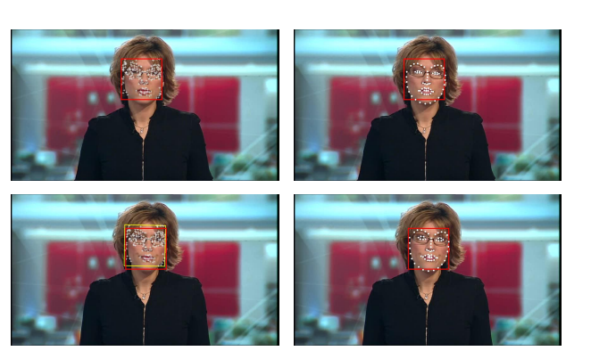
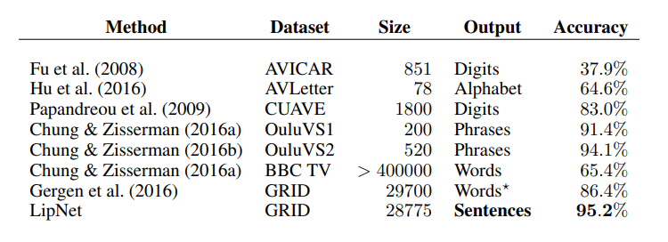
4
Literature Review
LIPNET: END-TO-END SENTENCE-LEVEL LIPREADING (2016)
GRID corpus
STCNN layers, Bi-GRUs and CTC loss
Maximum 6 words sentence
Lip Reading In The Wild (2016)
Featuring over a million word instances
CNN architecture - modifying VGG-M model
MT model: top-1 accuracy of 65.4% and top-10 accuracy of 92.3%
Turkish lip-reading using Bi-LSTM (2022)
Two new datasets
Speakers positioned at 1.5 meters in lighting
CNN-BI-LSTM
84.5% for words and 88.55% for sentences

Slide 5
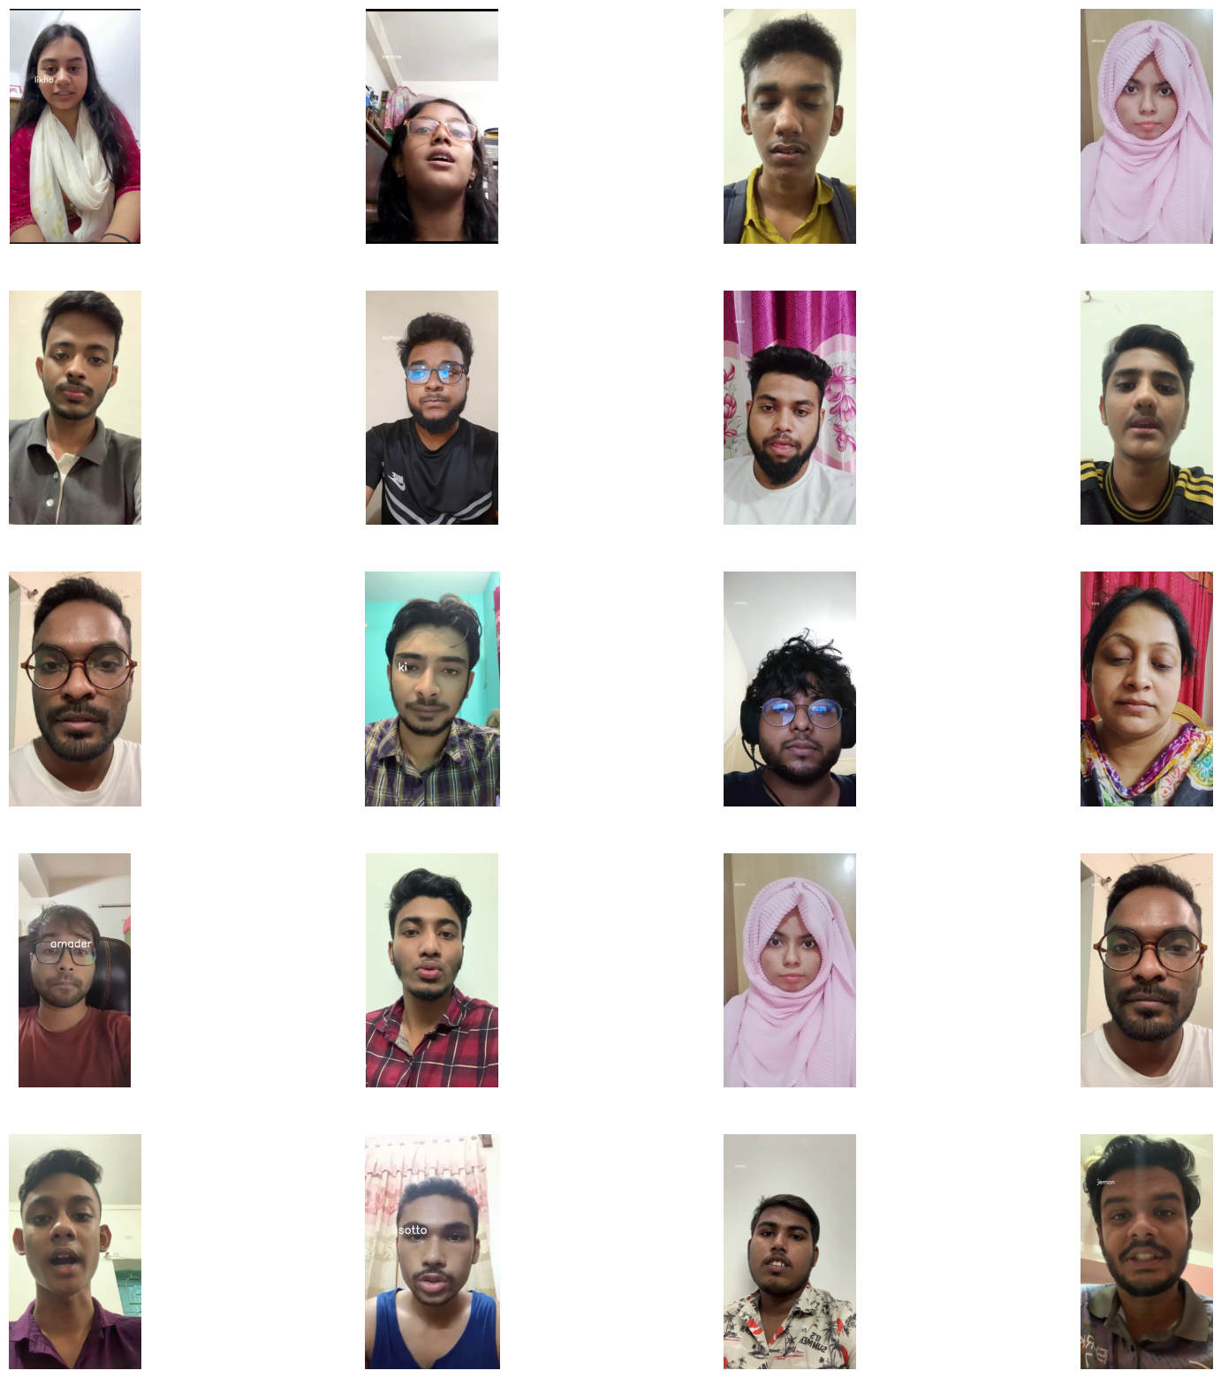
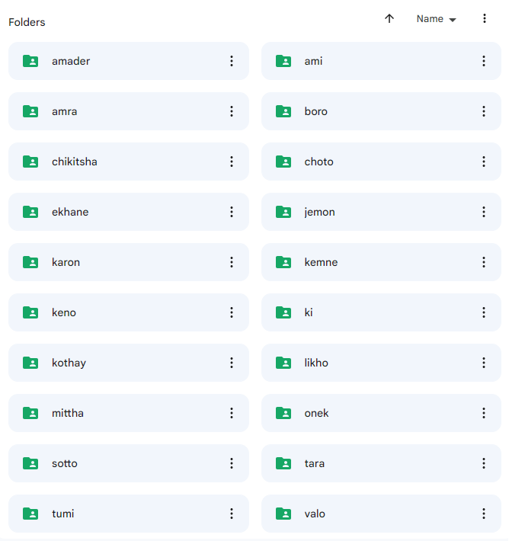
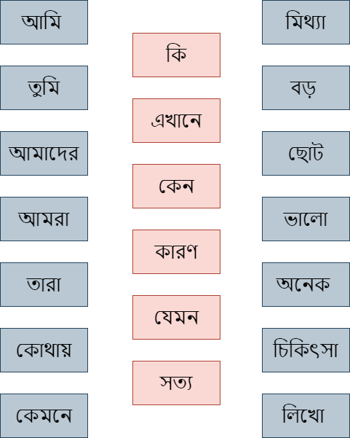
Dataset
Adelyn Keller
Charles Jones
5
20 words
65 Speakers
4000 videos
Fig: Sample speakers
Fig: 20 selected words
Fig: Visual of the Dataset

Slide 6
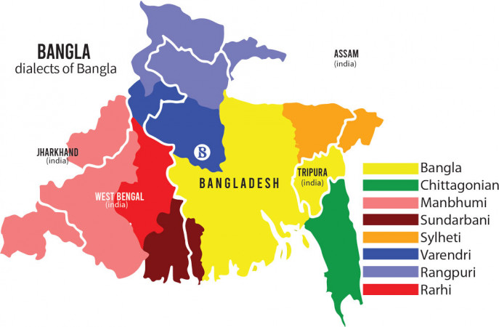
Speaker Segment
6
Fig: Bangla Dialects
Challenging due to the diverse accents.
Selected individuals from Dhaka to maintain consistency.
Observed pronunciation differences.

Slide 7
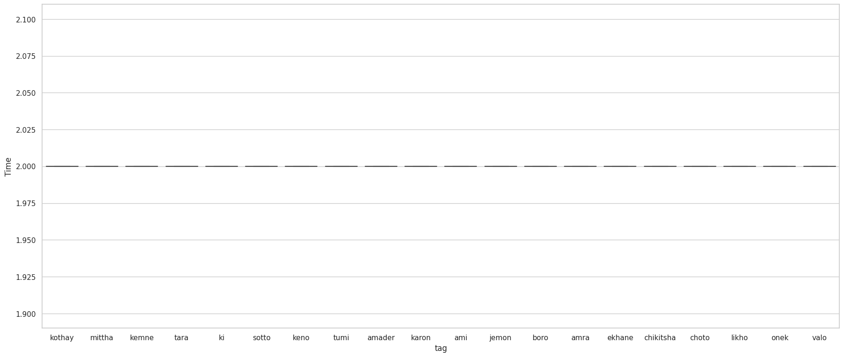
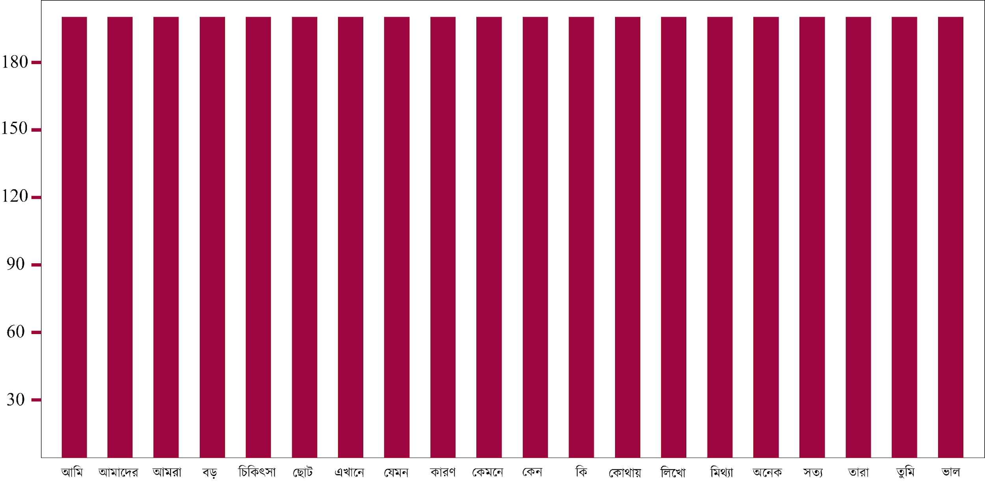
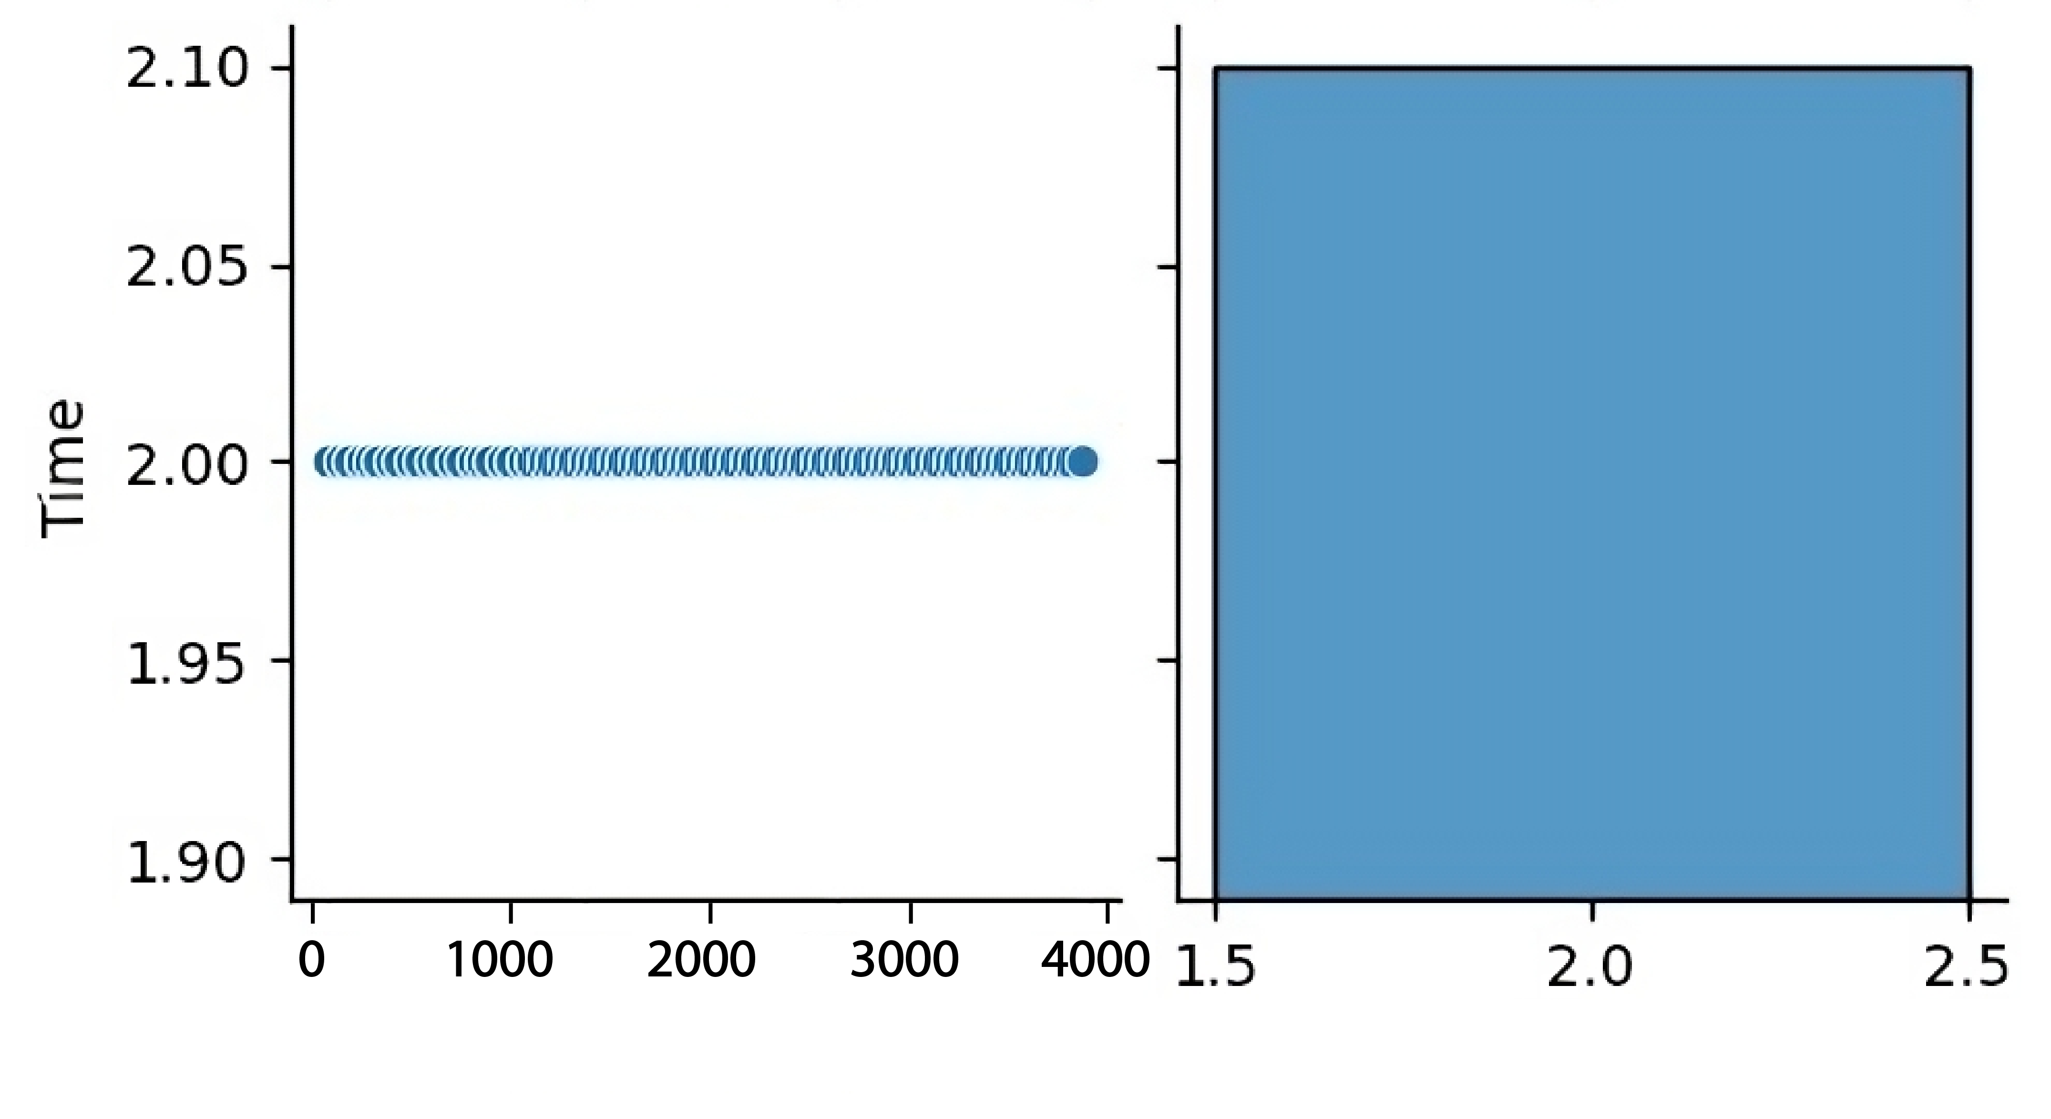
Exploratory Data Analysis
7
Fig : Average time of video
Fig : Number of videos per word
Balanced data
No of videos
Fig : Total videos

Slide 8
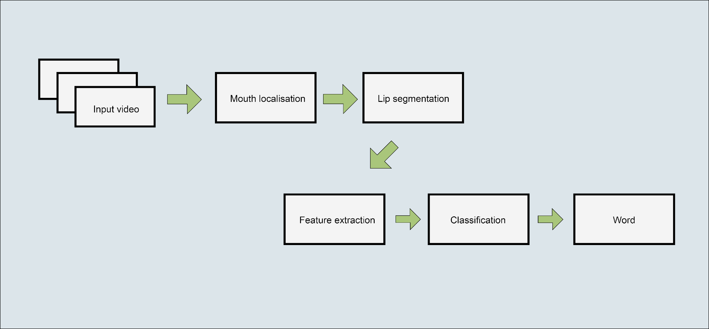
8
Preprocessing
Video Editing
Adjusted poor lightings
Cut words from mixed word videos
Trimming unnecessary parts
Remove unusable videos
Extract Frames
Converts video into frames.
Saves each frame as image.
Control number of frames extracted per second.
Extracted 30 frames per video.
Grayscale
Fig : Lip reading process

Slide 9
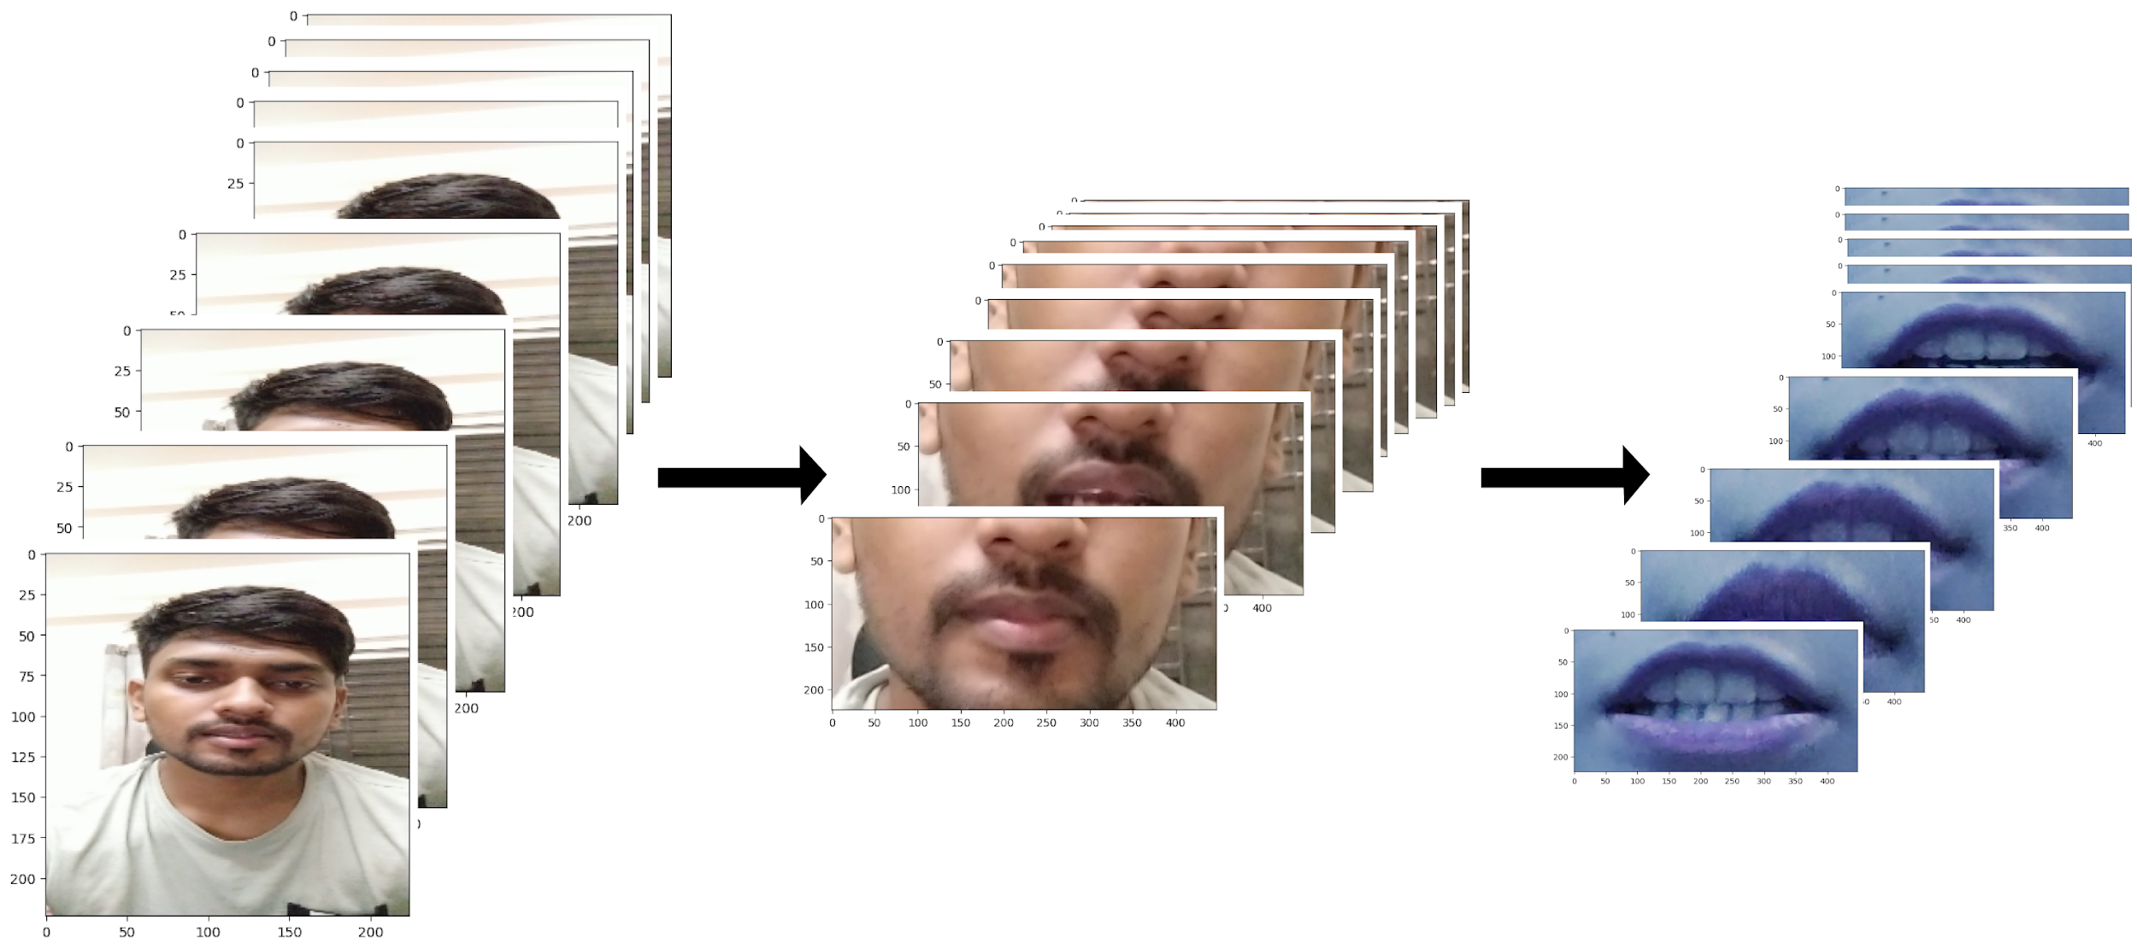
9
Preprocessing
Face Detection & Crop Lip Region
Face landmark predictor and frontal face detector.
“face_detector” from dlib library to identify face locations.
lip_region_scale for adjusting lip region size.
Defines dimensions for the lip region.
Resize and Normalization
Images resized to a fixed height and width (200x100).
Scaling pixel values in between 0 and 1.
Fig : Lip Segmentation

Slide 10
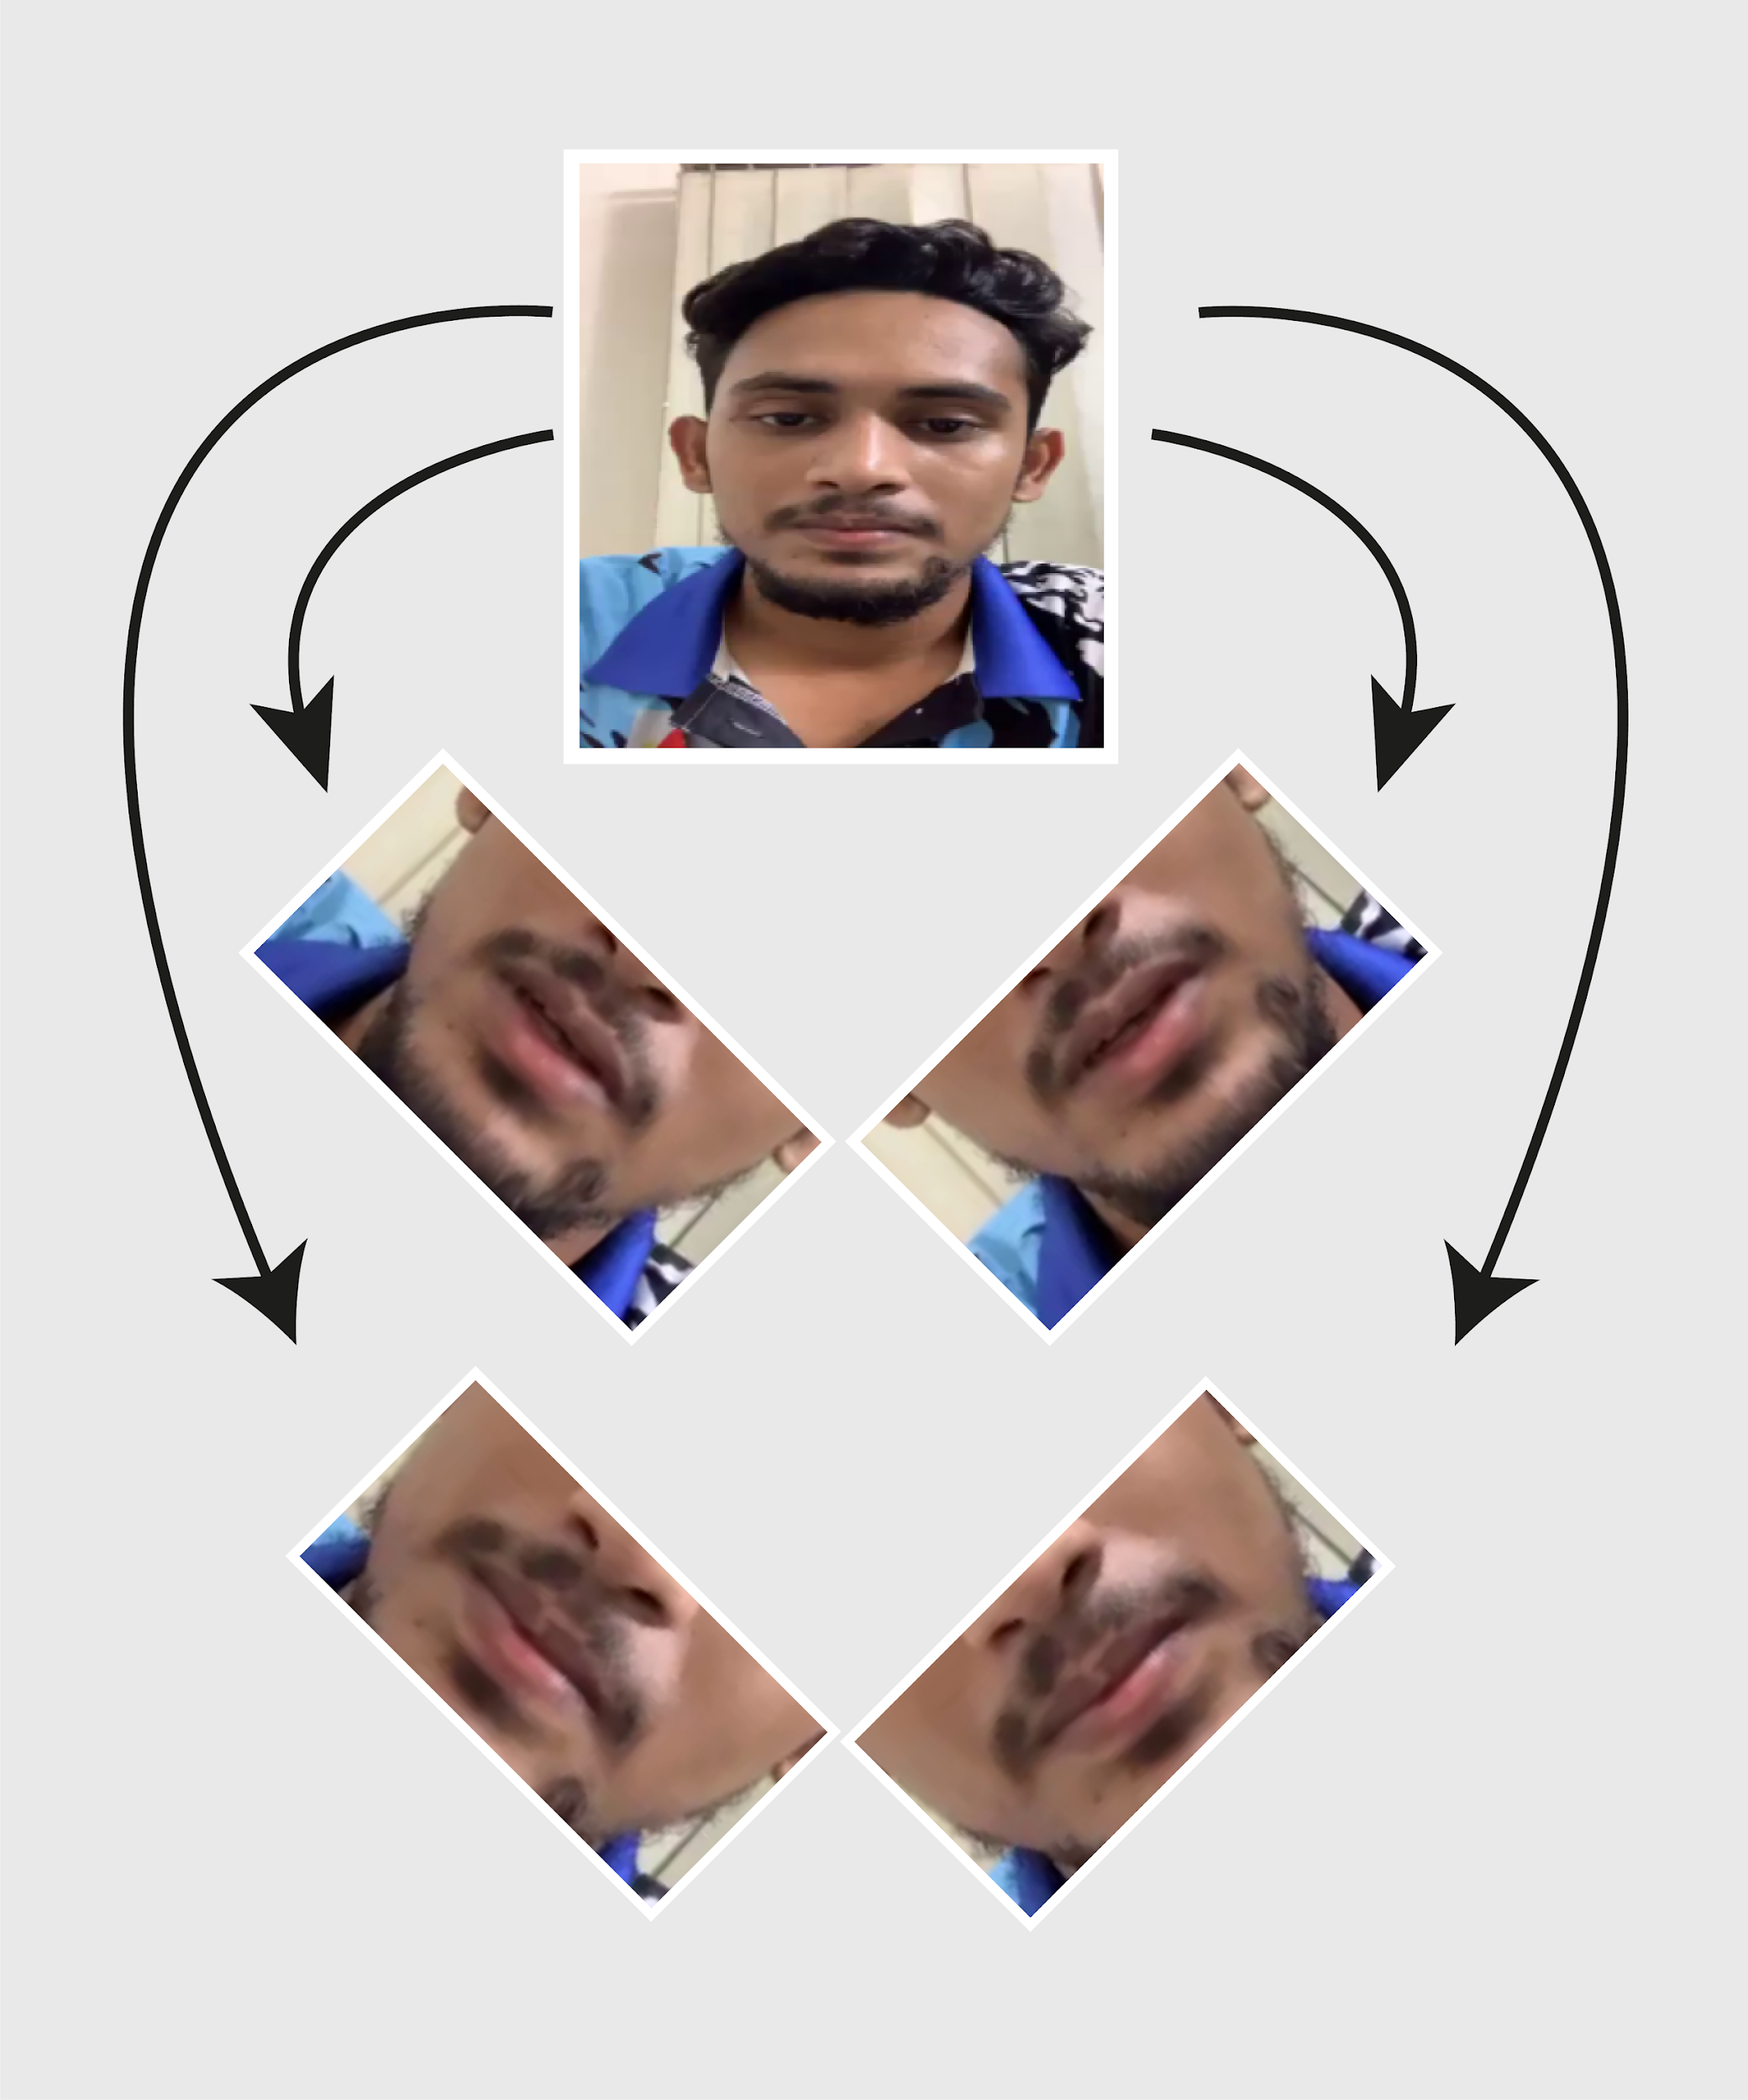
10
Preprocessing
Padding
Frames >30: add frames at regular intervals.
Frames < 30: Add duplicate frames to the beginning and ending
Augmentation
Utilization of Albumentation Library:
Applied to grayscale frames
Shifts: horizontal and vertical
Rotation range: 20 degrees,
Flip images
Fig : Rotation of frames in augmentation

Slide 11
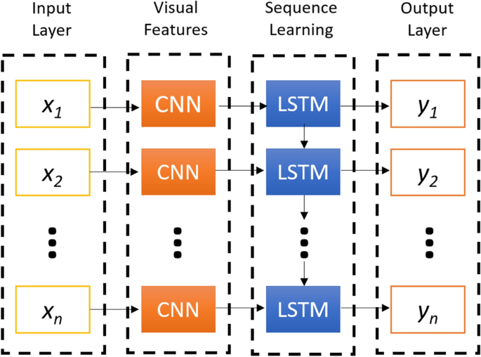
Architecture: CNN-RNN
11
CNN-RNN Architecture:
Combines CNN and RNN layers.
Output of RNN is passed to a fully connected layer for classification.
Why CNN-RNN:
CNN to extract relevant features.
RNN to interpret the sequence of frames.
.
Other Architectures:
Transformer-based models which use self-attention mechanisms.

Slide 12
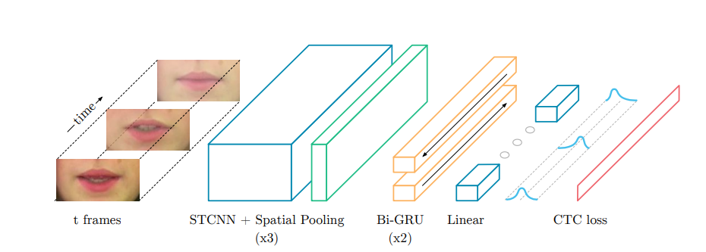
Model: LipNet
What is LipNet:
- First sentence-level lipreading model.
- Outperforms previous word-level models.
12
Architecture:
Implementation
- Input dimensions (30, 100, 200, 1)
- Used: Keras with TensorFlow
- Input layer : TimeDistributed Conv2D
- Output layer: 'softmax' activation
- Used categorical cross-entropy as CTC loss was computationally expensive

Slide 13
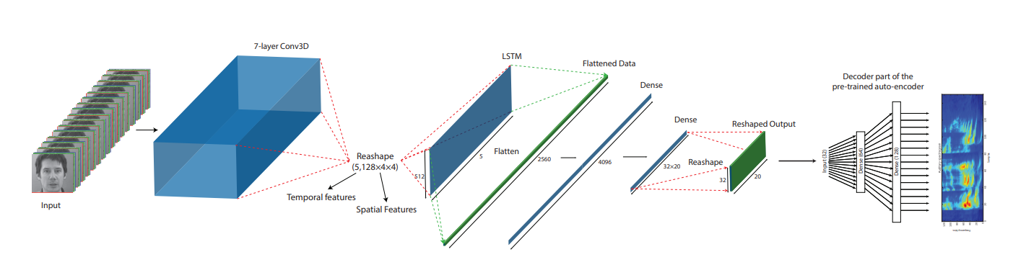
Model: Autoencoder-Decoder
13
What is Autoencoder-Decoder?
Combines CNNs and LSTM networks.
Utilizes an auditory spectrogram for reconstructed speech
Architecture:
7-layer 3D convolutional network, 1 layer LSTM
Output layer produces bottleneck features for the decoder​​.
Reconstructed auditory spectrogram used to regenerate the audio waveform
Implementation:
Focused on identifying spoken words, not generating audio.
Decoder not used in this application.

Slide 14
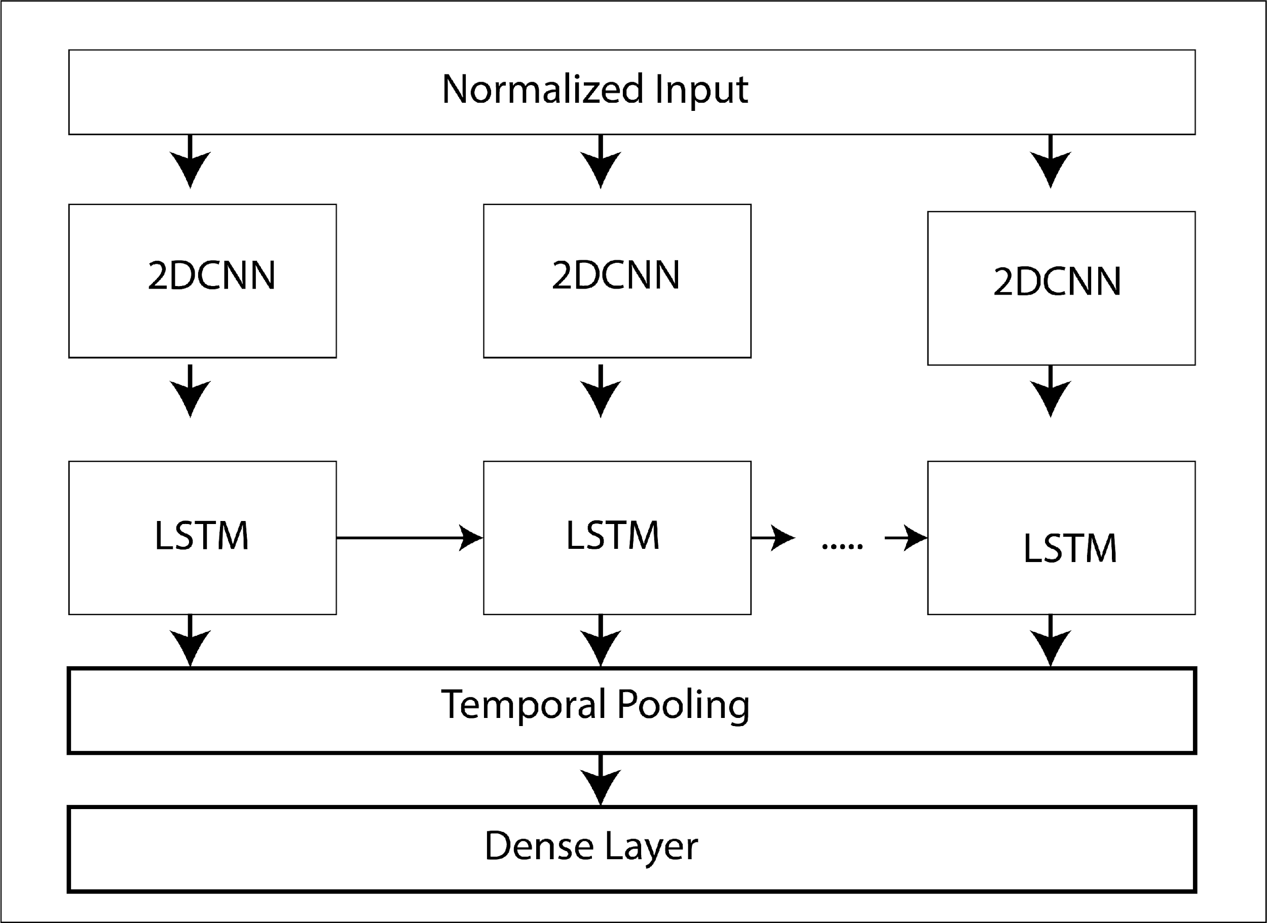
Custom Model 1:
14
Architecture:
CNN-RNN architecture similar to LipNet.
3 layers of Timedistributed 2D Convolutional with (3,3) kernel size
Employs LSTM
TimeDistributed Flattening
Categorical crossentropy and softmax activation

Slide 15
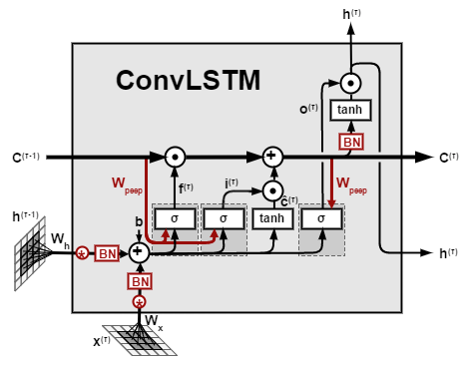
Custom Model 2:
15
ConvLSTM:
- Extension of the traditional LSTM model.
- Process temporal and spatial correlations concurrently.
Why ConvLSTM?
- Spatial information is preserved
- Doesn't require data flattening before processing.
- In CNN-RNN spatial structure is lost after flattening
Implementation:
Input Shape: (30, 100, 200, 1)
ConvLSTM2D Layers with TimeDistributed
GlobalAveragePooling3D Layer to reduce output’s
Consists of 512 and 1024 unit Dense layers

Slide 16
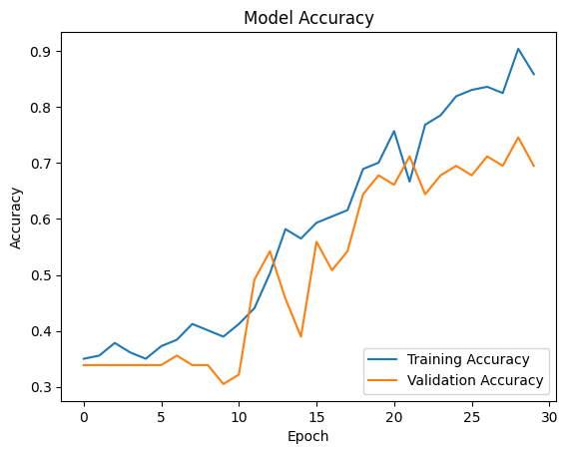
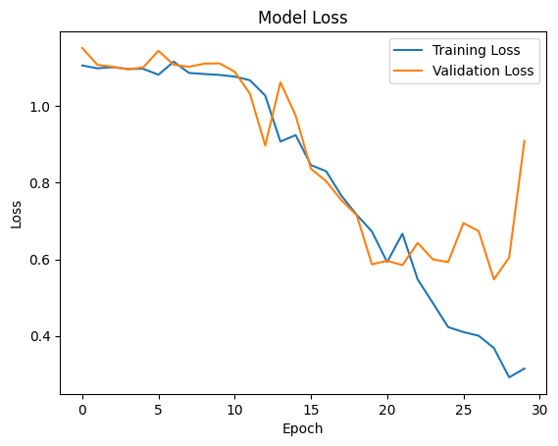
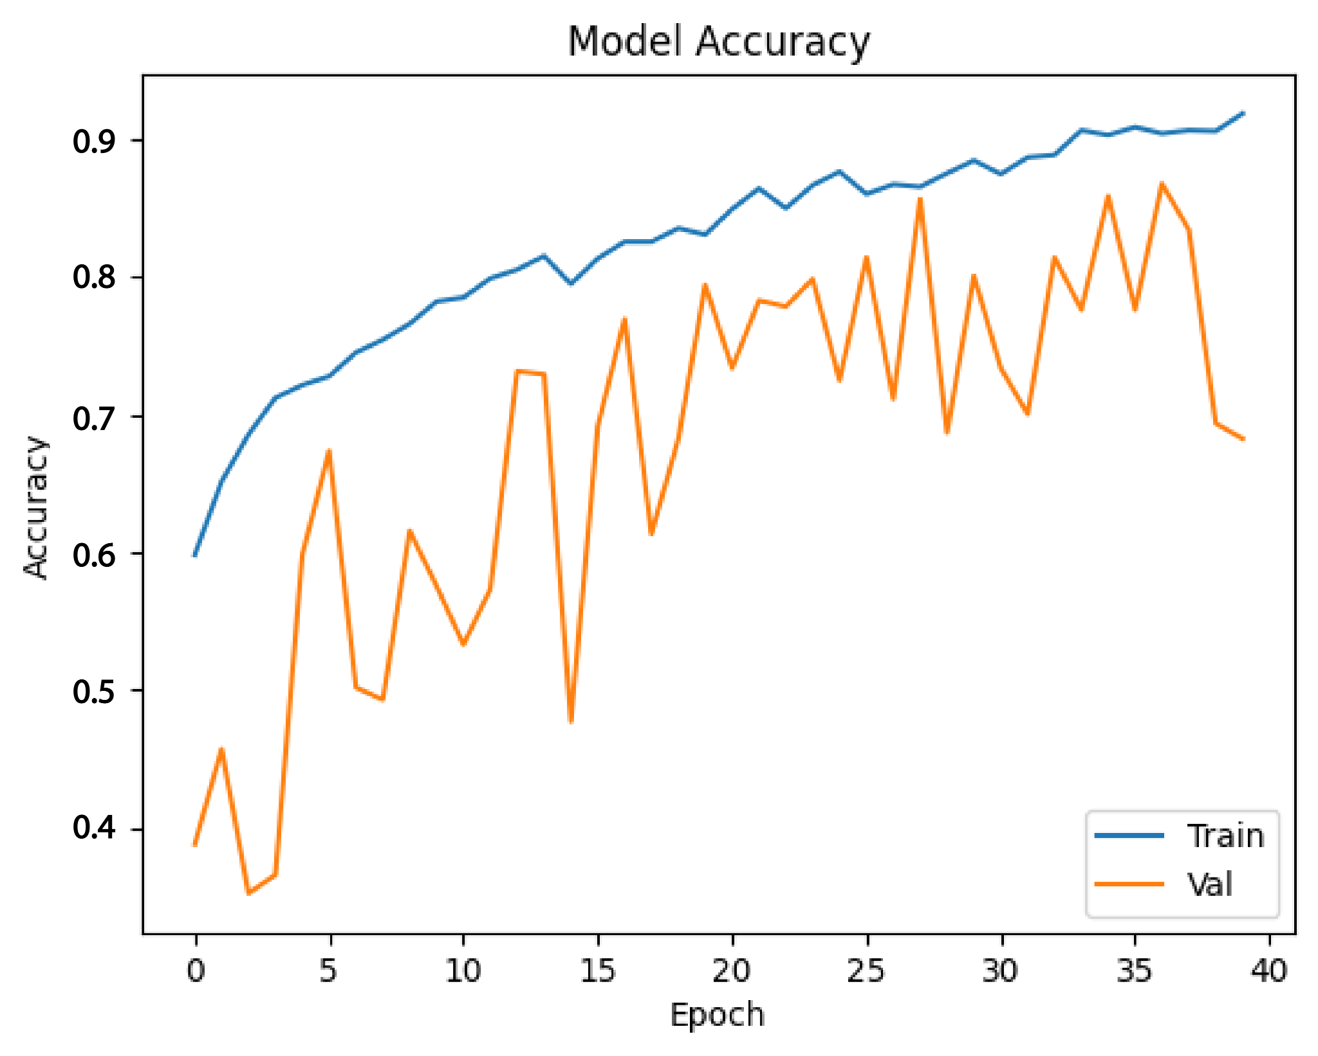
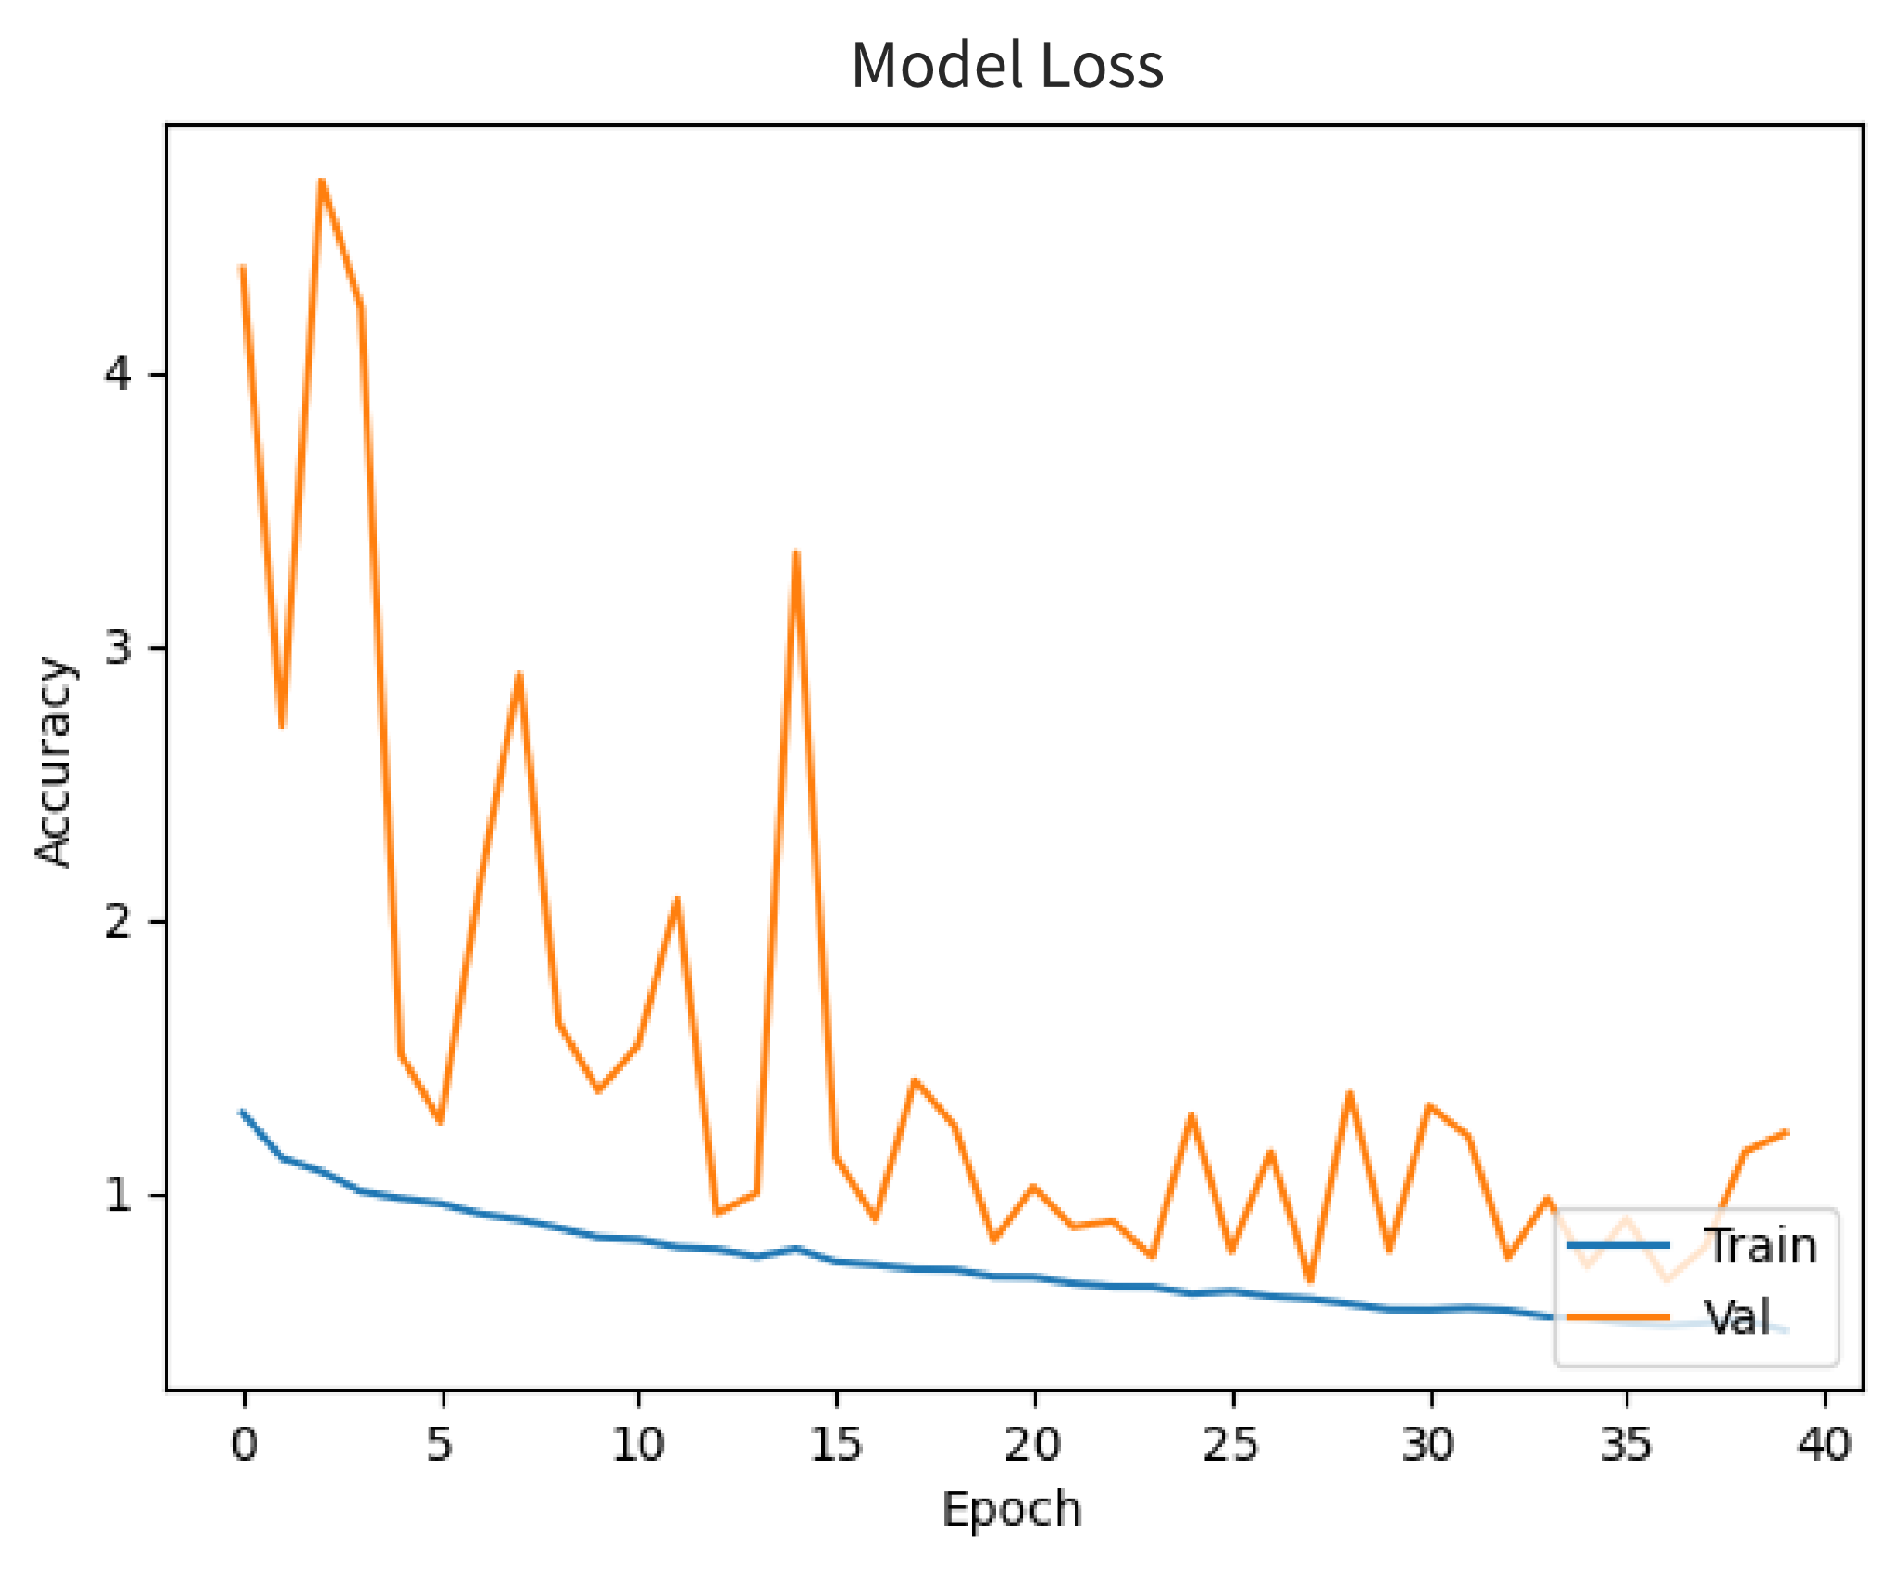
Result
16
Custom model-1
learning trajectory observed over 30 epochs
Validation loss initially decreases
Indicating potential overfitting
Validation accuracy increases
Training accuracy consistently increases
Custom Model - 2
Training accuracy increases over 40 epochs
Validation accuracy fluctuates
Indicating potential overfitting
loss graph indicating decreasing loss over time
validation loss curve is highly unstable

Slide 17
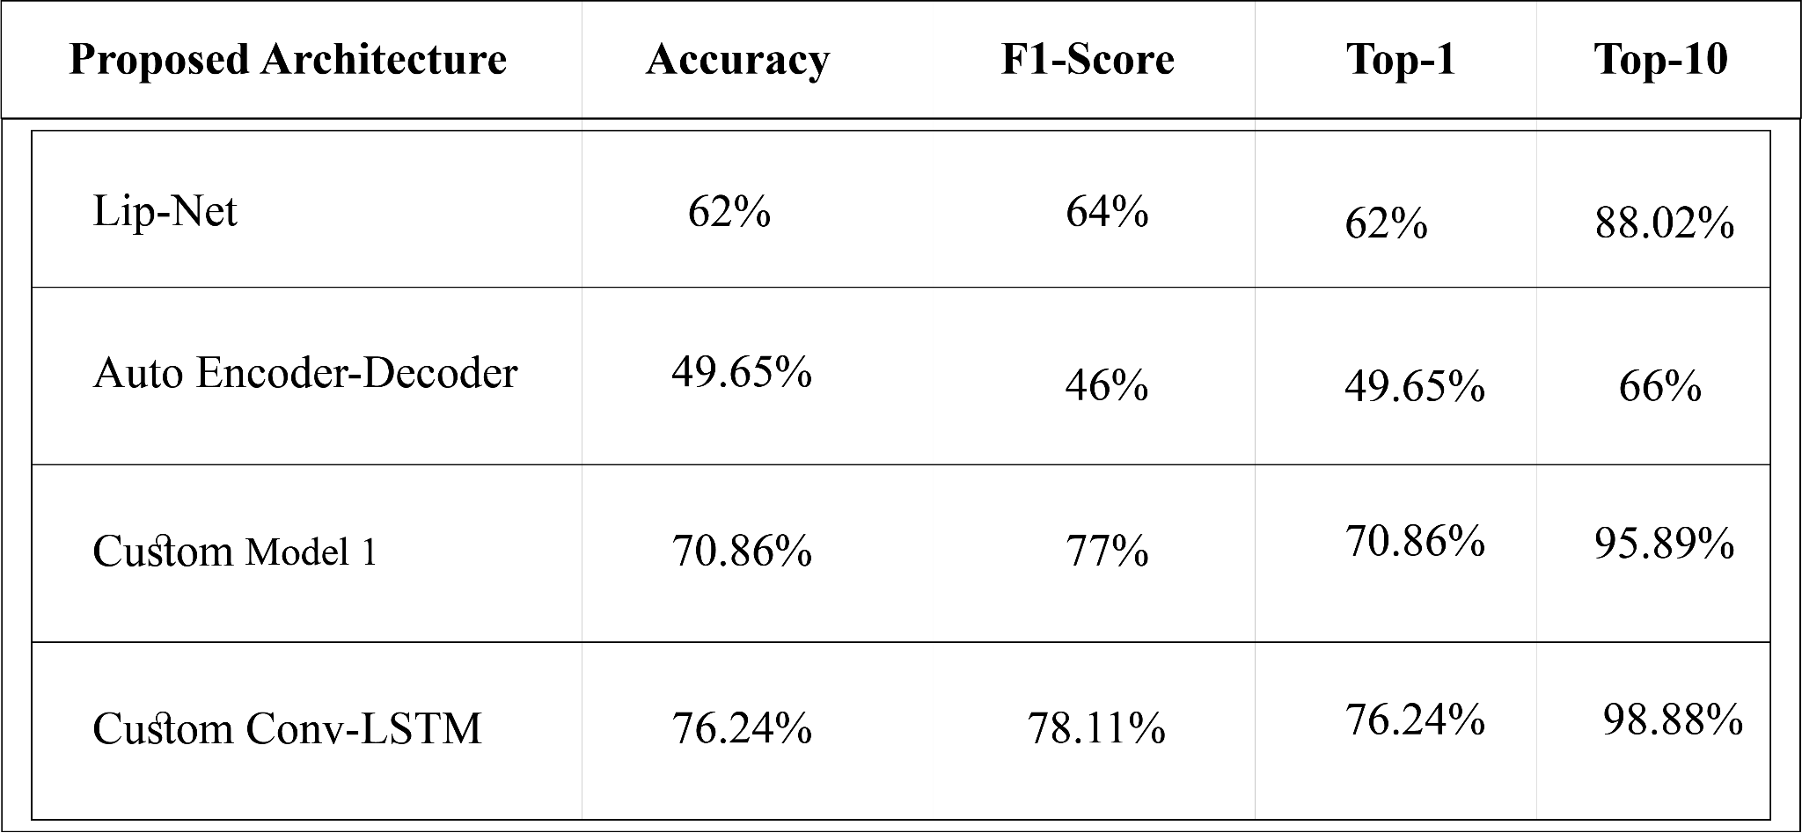
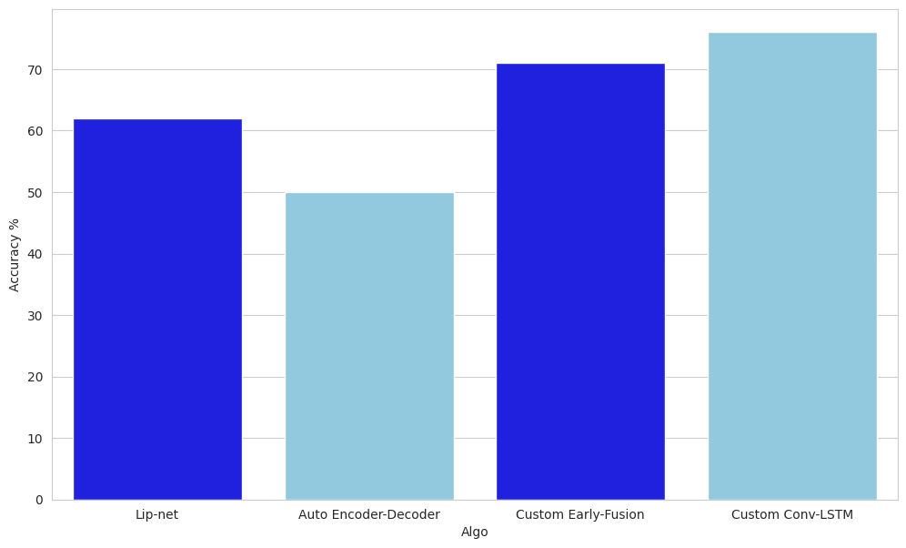
Evaluation of Models
17
Strong balance between precision and recall, demonstrated by a high F1-Score.
Custom model-2 has the higher accuracy

Slide 18
18
Future Works
Increase dataset with more words and speakers
Transformer-based models which use self-attention mechanisms
Use lip reading for sentence level

Slide 19
19
References
Y. M. Assael, “Lipnet: End-to-end sentence-level lipreading,” arXiv preprint arXiv:1611.01599, 2016.
J. S. Chung, A. Senior, O. Vinyals, and A. Zisserman, “Lip reading sentences in the wild,” arXiv preprint arXiv:1611.05358, 2016. [Online]. Available: https: //www.robots.ox.ac.uk/∼vgg/publications/2016/Chung16/chung16.pdf.
S. Chung and A. Zisserman, “Lip reading in the wild,” in Asian Conference on Computer Vision, 2016.
H. Akbari, “Lip2audspec: Speech reconstruction from silent lip movements,” arXiv preprint arXiv:1710.09798, 2017.
U. Atila and F. D. Sabaz, “Turkish lip-reading using bi-lstm and deep learning models,” Engineering Science and Technology, an International Journal, vol. 35, p. 101 206, 2022.

Slide 20
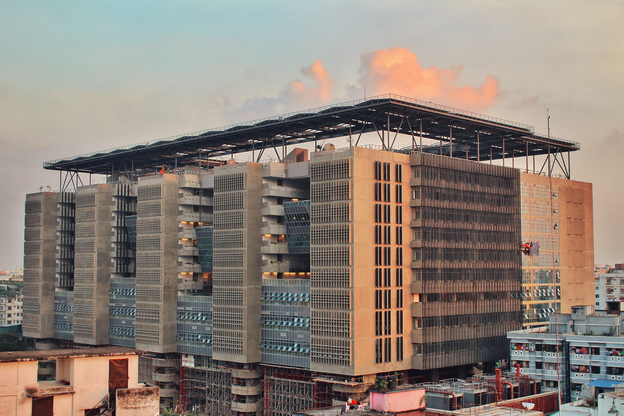
Thank You!

